Slide 1
Database management with mysql
Software development tools presentation week 5
On

Slide 2
Introduction
Our website project which is a travelling booking system, Glidebook, would have to deal with a lot of data from user booking information, agencies and more. This data will have to be stored, retrieved and manipulated, so we need a database.
To intergrate a database into our project, we will need an appropriate database management system (MYSQl) and a standard language use in this system(MSQL).

Slide 3
Definition and explanation of terms

Slide 4
Database concepts
The data in an RDBMS is stored in database objects called tables.
A table is a collection of related data entries and it consist of columns and rows
A record, also called a row is each individual entry that exist in a table . It is a horizontal entity in a table
A field, also called a column is a vertical entity in a table that contains data of the same type

Slide 5
SQL AND MYSQL (1/2)
WHAT IS SQL?
SQL is the standard language for storing, manipulating and retrieving data in databases
It stands for Structured Query Language
In this case, it will be used for creating and modifying database and tables as well as executing queries in these.

Slide 6
SQL AND MYSQL (1/2)
WHAT IS MYSQL AND WHY USE IT AS OUR RDBMS DATABASE PROGRAM
An RDBMS is the basis for sql and it is the entity in which the data is stored in the form of databases.
MYSQL is popular database software for websites which is very powerful, robust and and a full featured SQL database system.
We will use MYSQL because it is an inexpensive alternative compared its counterparts like ms server and oracle solutions

Slide 7
General concepts
For our website to retrieve and store data from the database, the web server (APACHE) should have access to the RDBMS (MYSQL) that uses the SQL language.

Slide 8
XAmpp
XAMPP is the local development environment which we used to implement this phase of the project. It includes;
APACHE: Widely used web server software
MySQL:
PHP: Popular server scripting language for web development. This connect to and enable the manipulation of the databases.

Slide 9
MOST IMPORTANT SQL COMMANDS
SELECT - extracts data from a database
UPDATE - updates data in a database
DELETE - deletes data from a database
INSERT INTO - inserts new data into a database
CREATE DATABASE - creates a new database
ALTER DATABASE - modifies a database
CREATE TABLE - creates a new table
ALTER TABLE - modifies a table
DROP TABLE - deletes a table
CREATE INDEX - creates an index (search key)
DROP INDEX - deletes an index

Slide 11
Building a database

Slide 12
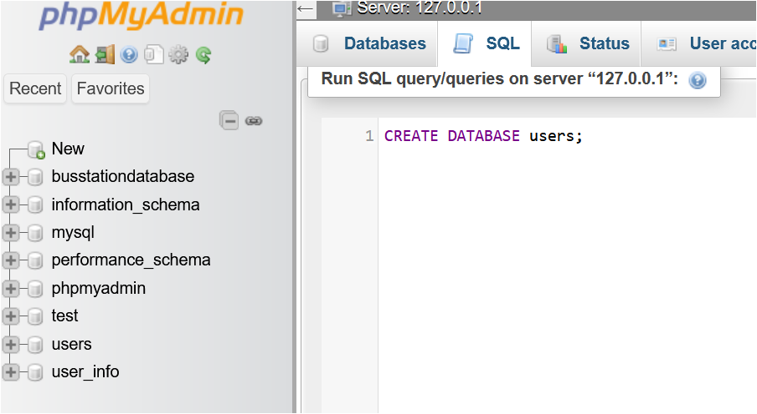
CREATING A DATABASE

Slide 13
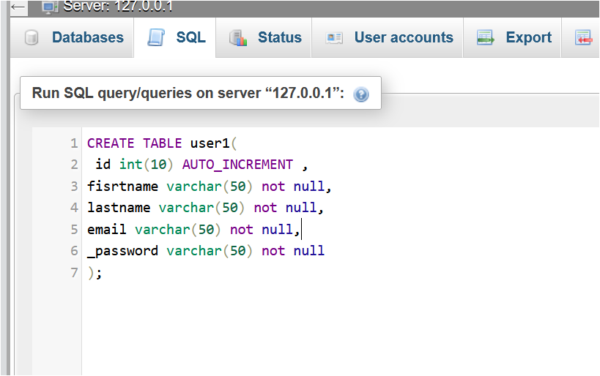
Creating tables
The table user1 was created.
It stores users’ information during signup

Slide 14
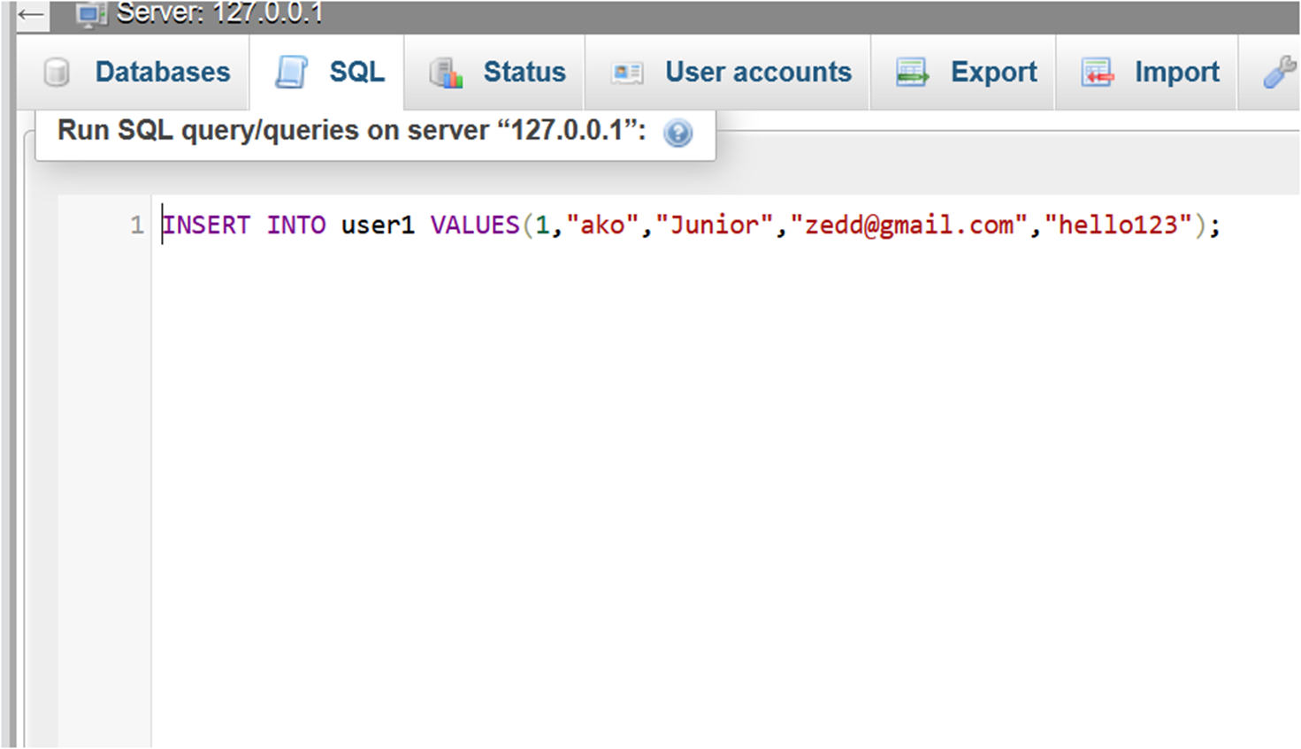
Inserting data
Populating the user1 table

Slide 15
Connecting the database to the web application

Slide 16
With PHP, you can connect to and manipulate databases
A PHP script is executed on the server
PHPMYADMIN was the web host(server) supporting PHP .
PHPMYADMIN is a part of the apache packet

Slide 17
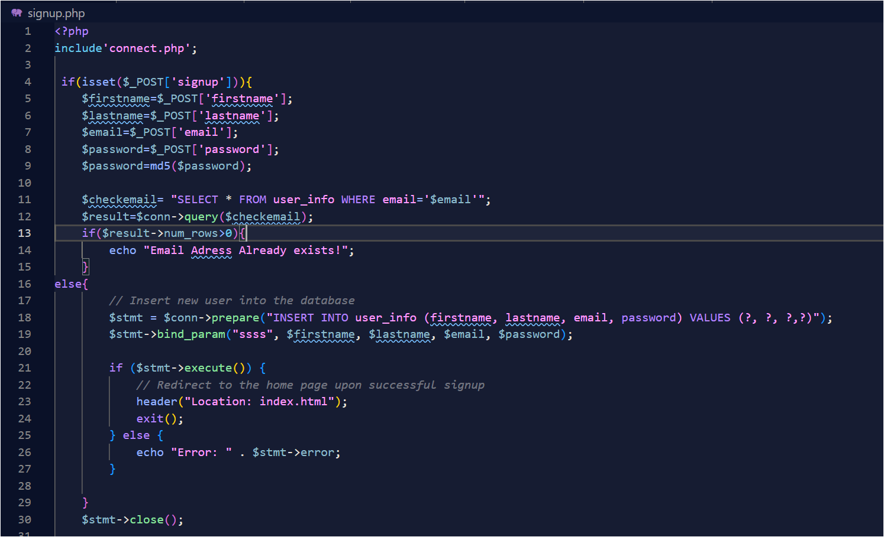
Database intergration
SQL queries implemented for the data manipulation of the signup page
This query inserts new records into user_info table

Slide 18
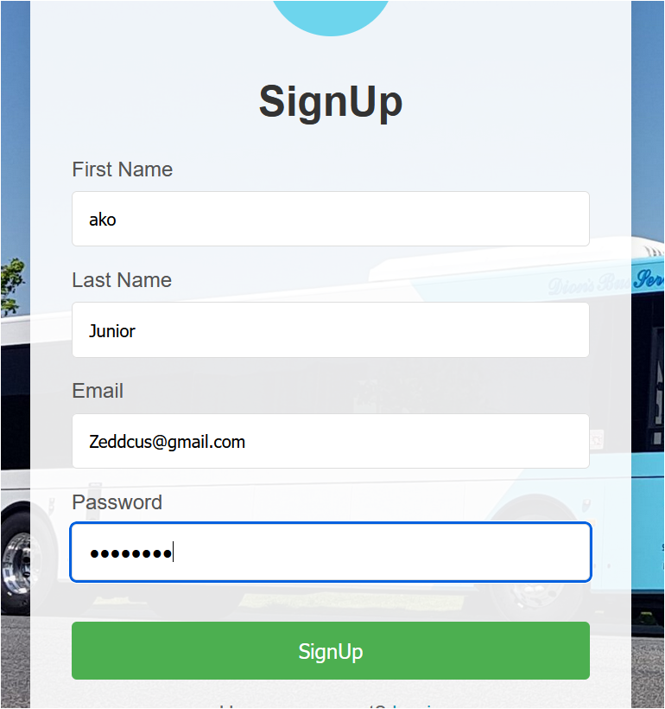
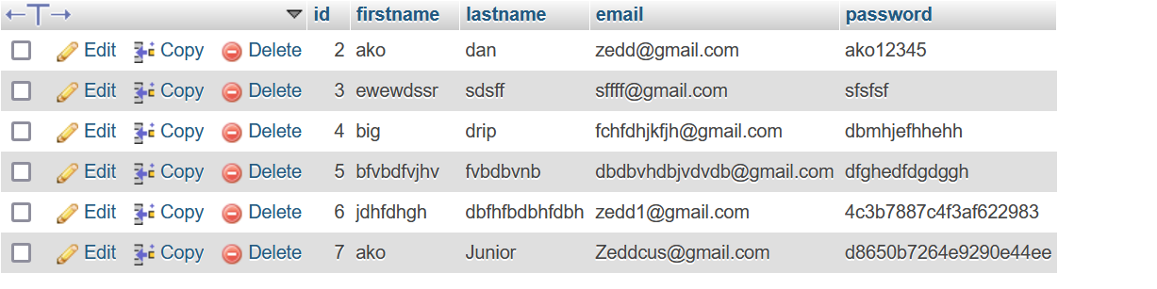
Demo of intergration

Slide 19
Backend development with node.js and express
Software development tools presentation week 6
On

Slide 20
introduction
SO, WHAT IS THE BACKEND OF A WEBSITE:
Server-side logic of a website that powers its core functionality.
Handles the database operations, API endpoints and user authentication
It is the part of the website that is not usually visible or accessible to the user

Slide 21
Tools used
NODE.JS
It is an open source server environment which uses JavaScript on the server.
Node.js can generate dynamic page content
It can create, open , read to, write to, delete and close files on the server
It can collect form data
It can add, delete, modify data in a database

Slide 22
EXPRESS
A lightweight Node.js web application framework
It is used for building REST APIs and Web applications
It builds a backend system that powers the webapplication by handling data and logic

Slide 23
Rest api
REST API stands for Representational State Transfer (REST) Application programming interface
It enables the communication between the client and server using HTTP methods
The HTTP Methods used are;
Get: Retrieve data from the server
Post: Submit new data to the server
Put: Update existing data
Delete: Remove data from the server

Slide 24
Setting Up Node.js and Express on VS Code
Download and Install Node.js
Create a folder for backend projects and initialize it so it becomes a server
Install Express
The express dependencies body-parser, mysql2 and dotenv are downloaded by running the following code on the terminal.

Slide 25
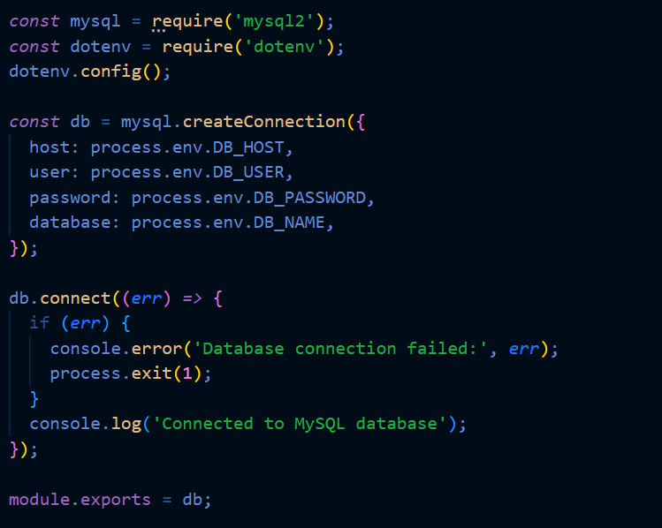
Connecting node.js to mysql database
Database:
Name: Busstationdatabase
Table: user_info
Columns: firstname, lastname, email, password
Integration Steps:
Create .env file for database credentials.
Write connection logic in config/db.js.

Slide 26
Signup endpoint
Frontend Flow:
The signup form collects user details (firstname, lastname, email, and password).
Sends a POST request with these details to the backend API.
Backend Flow:
The backend receives the data from the frontend.
Hashes the password using bcrypt for security.
Inserts user data into the MySQL user_info table.
Database Impact:
The user_info table is updated with the new user's data (hashed password included).

Slide 27
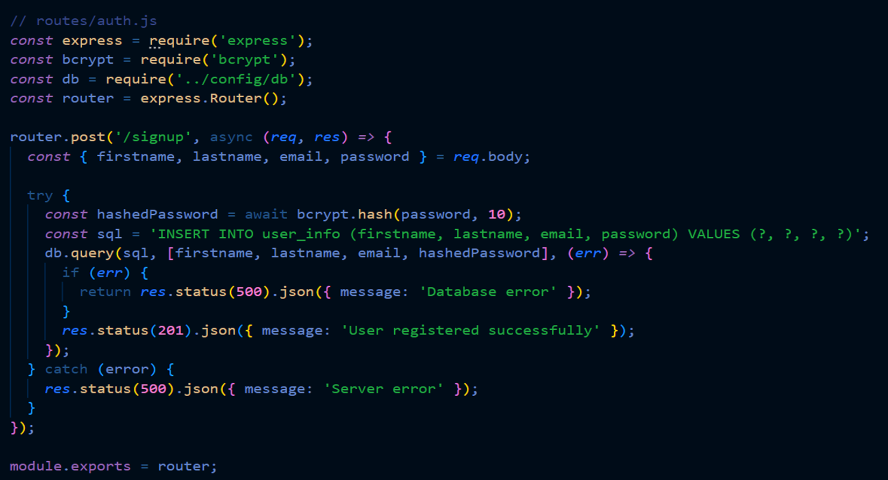

Slide 28
Login Endpoint
Frontend Flow:
The login form collects email and password.
Sends a POST request with these credentials to the backend API.
Backend Flow:
The backend checks if the email exists in the user_info table.
Verifies the password by comparing it with the hashed password stored in the database.
Returns a success message and user data (excluding the password) if valid.
Response to Frontend:
A successful login response allows the frontend to store user details or initiate a session.
Failure to input the correct credentials displays the message “Invalid email or password”

Slide 29
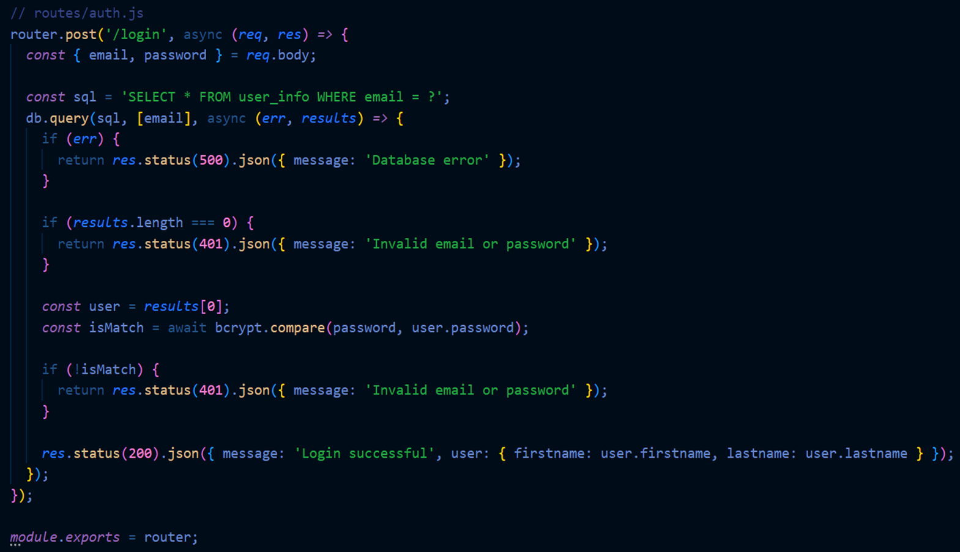
Login Endpoint

Slide 30
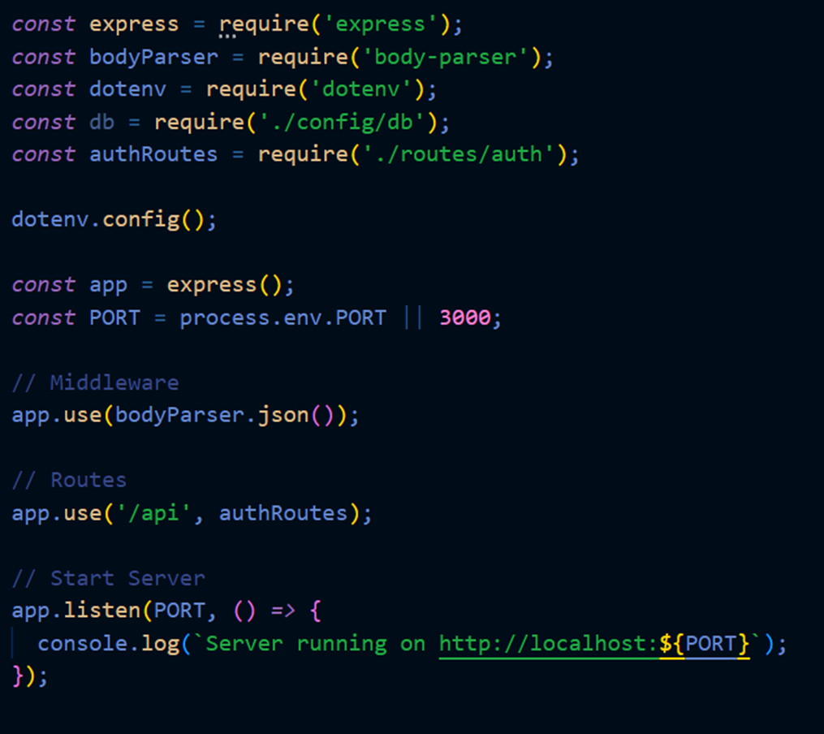
Configuring the Main Server
Connecting the endpoints to the main application in server.js

Slide 31
Api demonstration
GET- /api/user_info – Fetches Users from database
GET - /api/user_info/:id – Fetches a specific user from database
POST - /api/user_info – Adds another user to the database
PUT - /api/user_info/:id – Updates user information in the database
PATCH - /api/user_info/:id – Updates Specific information for a user in the database
DELETE - /api/user_info/:id – Deletes a specific user from the database

Slide 32
Thank you!

